Slide 2

Tord Glad Nordahl
Take control over the citizen integrator
@tordeman

Slide 3
Competition
Send a Tweet with this hashtag #TP2B
Last random 10, and happy score above 0.8

Slide 4





POWER BI
POWER AUTOMATE
POWER APPS
VIRTUAL AGENT
POWER PAGES

Slide 5
Power Platform
2021 Q4
7,4M+
POWER PLATFORM DEVELOPERS
BY 2024
65%
OF ALL APPLICATIONS WILL BE LOW CODE

Slide 6
The usual suspects
Duplicates
People leave
Spaghetti integration
Wrong usage
Mixing personal data with company data
Security risks (GDPR, company policy etc.)

Slide 7

Meet Orack Bama
Business Controller
Likes tech
Have Phillips Hue at home and claims it is a smart home
Notes:
Alder

Slide 8


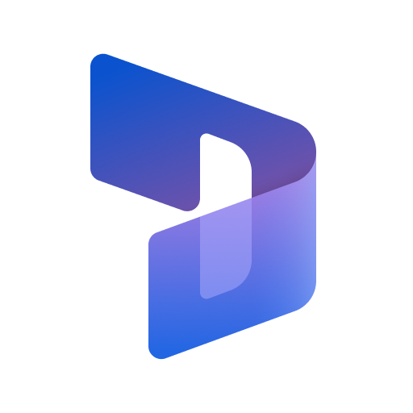
Orack built a PowerAutomate
ORACKS MAILBOX
SEND MAIL TO SALES
SHARED MAILBOX
RECEIVE MAIL
POWER AUTOMATE
READS MAIL
FINANCE AND OPERATION
REGISTER SALES

Slide 9
Pros and Cons
Simple automation
Makes the life easier for Orack and removes a lot of possible waste time
Simple logic
Notifies the right resources, email or directly to the system
Potential duplicates
Since these are picked from a shared mailbox, others may manually process them
Relies on Orack user
If Orack account is blocked, the integration stop

Slide 10

Orack built a PowerAutomate RPA
FINANCE AND OPERATION
READS INVOICE
POWER AUTOMATE RPA
CAPTURE DATA
COMPANY BANK
TRANSFER INVOICE DATA

Slide 11
Pros and Cons
Simple automation
Always send the right fields from the system
Simple logic
Automates a manual work into the bank system
Potential risk
Original values can be altered by anyone with access to the system
Relies on Orack user
If Orack account is blocked, the integration stop

Slide 12
DEMO Power Automate Grow up to Logic App
Notes:
https://emea.flow.microsoft.com/manage/environments/Default-65f51067-7d65-4aa9-b996-4cc43a0d7111/connections/available/custom/shared_nicconference-5f704789e17a032f85-5fbe7d51a485daa29c/edit/test

Slide 13


CHECK FOR ABNORMALITIES
IF NORMAL OR APPROVED
ASK FOR APPROVAL

Slide 14

Meet Lirva Alvign
Support technican
Into sk8rboys
Knows the password to the CEO account
Notes:
Alder

Slide 15

LIRVA built a PowerApp
GET TICKETS
WITH FILTER
PRESENT TICKETS
PREDEFINED ANSWERS
UJPDATE TICKETS
NOTIFY THE CUSTOMER

Slide 16
Pros and Cons
Easy to use templates
Can speed up the deliverable of standard incidents
No business logic
Lacks business logic to do any magic, like reset password
Wrong connectors
Directly connect to database when APIs are built for these actions
Risk on data gathering
If developed poorly, it can hammer your system

Slide 17

Valuable services?
safe services?
Notes:
https://www.polleverywhere.com/multiple_choice_polls/HogY3RphW9iRuDvvx7wPM
Mentimeter
Slido -

Slide 18

Custom Connectors
Create simple connctors to control internal data
A custom connector is a wrapper around a REST API (Logic Apps also supports SOAP APIs)
Secure your connector and your data
USE FOR POWER AUTOMATE
USE FOR POWER APPS
USE FOR LOGIC APP
Notes:
Generic OAuth 2.0
OAuth 2.0 for specific services, including Azure Active Directory (Azure AD), Dropbox, GitHub, and SalesForce
Basic authentication
API Key

Slide 19
DEMO Custom Connector
Notes:
https://emea.flow.microsoft.com/manage/environments/Default-65f51067-7d65-4aa9-b996-4cc43a0d7111/connections/available/custom/shared_nicconference-5f704789e17a032f85-5fbe7d51a485daa29c/edit/test

Slide 20
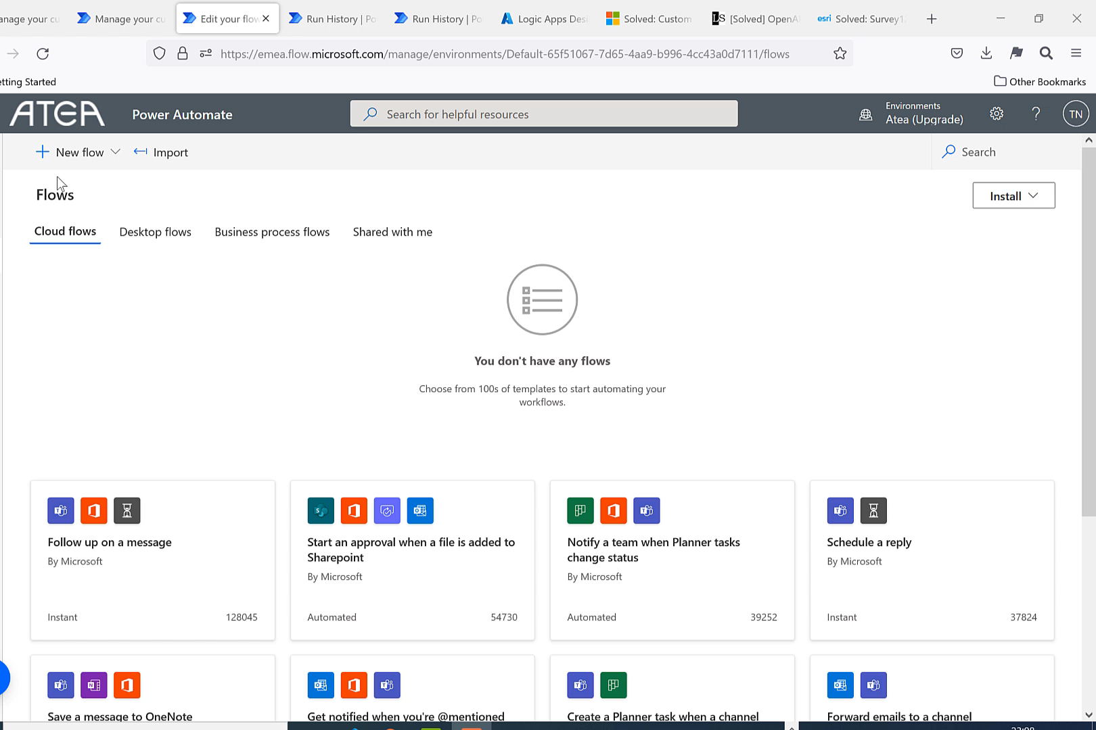

Slide 21
Tips from trade
Don’t connect directly to datasources
Build Custom Connectors to control citizen integrators

Slide 22




Cloud Integration
LOGIC APP
SERVICE BUS
EVENT GRID
FUNCTIONS
API MGMT
A fully managed event service cross azure services
Write small microservices of code
Control, mange and expose your APIs
Business logic and connectors
Queuing services in the Azure cloud

Slide 23
Most common asks
How to we secure our platform?
How can we take advantage of this?
How is this compared to other competitors?

Slide 24
Slides and demos from the conference will be available at
https://github.com/nordicinfrastructureconference/2022

